Slide 1
BREAST CANCER PREDICTON
CAPSTONE PROJECT
Presented By:
1. RIYA BHARGAVA-INDERPRASTHA ENGINEERING COLLEGE-IT

Slide 2
OUTLINE
Problem Statement
Proposed System/Solution
System Development Approach (Technology Used)
Algorithm & Deployment
Result
Conclusion
Future Scope
References

Slide 3
Problem Statement
Breast Cancer is one of the leading cancer developed in many countries including India. Though the endurance rate is high – with early diagnosis 97% women can survive for more than 5 years. Statistically, the death toll due to this disease has increased drastically in last few decades. The main issue pertaining to its cure is early recognition. Hence, apart from medicinal solutions some Data Science solution needs to be integrated for resolving the death causing issue. This analysis aims to observe which features are most helpful in predicting malignant or benign cancer and to see general trends that may aid us in model selection and hyper parameter selection. The goal is to classify whether the breast cancer is benign or malignant. To achieve this i have used machine learning classification methods to fit a function that can predict the discrete class of new input.

Slide 4
Proposed Solution
Content:
Objective:
Develop a machine learning model that predicts the presence of breast cancer using patient data.
Benefits:
Improved early detection rates.
Reduced healthcare costs by minimizing unnecessary tests.
Enhanced decision-making for healthcare providers through a reliable predictive tool.

Slide 5
System Approach
Data Collection:
Sources: Medical databases, public datasets (e.g., UCI Machine Learning Repository).
Types: Demographics, medical history, diagnostic test results (e.g., tumor size, texture).
Data Preprocessing:
Handling missing values.
Feature scaling and normalization.
Splitting data into training and testing sets.

Slide 6
Algorithm & Deployment
Chosen Algorithm(s):
Explain the selection of algorithms such as Logistic Regression, Decision Trees, Random Forests, Support
Vector Machines (SVM), and Neural Networks.
Justification:
Logistic Regression: Suitable for binary classification problems and provides probabilities for the presence
of cancer.
Decision Trees & Random Forests: Handle nonlinear relationships and interactions between features well.
SVM: Effective in high-dimensional spaces and works well with a clear margin of separation.
Neural Networks: Capable of capturing complex patterns in data, especially useful with large datasets.

Slide 7
Data Input
Input Features:
Demographics: Age, gender, family history of breast cancer.
Medical History: Previous diagnoses, treatments, genetic information.
Diagnostic Tests: Results from mammography, biopsy, ultrasound, MRI.
Biomarkers: Hormone receptor status (e.g., ER, PR), HER2 status.
Lifestyle Factors: Diet, exercise, alcohol consumption, smoking status.
Data Sources:
Public datasets (e.g., UCI Machine Learning Repository), hospital records, medical research databases.

Slide 8
Training Process
Content:
Data Preprocessing:
Handling missing values (imputation or removal).
Normalizing or standardizing continuous features.
Encoding categorical variables (one-hot encoding, label encoding).
Training:
Split Data: Train-test split (e.g., 80-20).
Cross-Validation: K-fold cross-validation to ensure model robustness.
Hyperparameter Tuning: Grid Search or Random Search for optimal model parameters.
Considerations:
Imbalanced Data: Techniques like SMOTE (Synthetic Minority Over-sampling Technique) to handle class imbalance.
Feature Selection: Recursive Feature Elimination (RFE) or feature importance from models like Random Forests.

Slide 9
Prediction Process
Content:
Model Deployment:
Web Application: Using frameworks like Flask or Django to create an interactive interface for users to input data and get predictions.
API Integration: Deploying the model as a REST API for integration with other systems.
Real-time Data Input:
Capability to input real-time patient data for on-the-fly predictions.
Integration with electronic health record (EHR) systems for seamless data flow.
Prediction Output:
Probability Score: Likelihood of the presence of breast cancer.
Binary Classification: Positive or negative prediction for breast cancer.
Explainability: Providing explanations for predictions (e.g., using SHAP values) to build trust with healthcare providers.

Slide 10
Result
Accuracy and Effectiveness:
Accuracy: The overall percentage of correctly classified instances in the dataset.
Precision: The proportion of positive identifications that were actually correct.
Recall (Sensitivity): The proportion of actual positives that were correctly identified.
F1 Score: The harmonic mean of precision and recall, providing a balance between the two.
ROC-AUC: The area under the receiver operating characteristic curve, representing the model’s ability to distinguish between classes.
Confusion Matrix:
True Positives (TP): Cases correctly predicted as having breast cancer.
True Negatives (TN): Cases correctly predicted as not having breast cancer.
False Positives (FP): Cases incorrectly predicted as having breast cancer.
False Negatives (FN): Cases incorrectly predicted as not having breast cancer.

Slide 11
Visualizations:
Confusion Matrix Visualization:
Display the confusion matrix as a heatmap to show the distribution of TP, TN, FP, and FN.
ROC Curve:
Plot the ROC curve to visualize the trade-off between sensitivity and specificity.
Show the AUC value to indicate the model’s performance.
Precision-Recall Curve:
Plot the precision-recall curve to provide insights into the trade-offs between precision and recall for different thresholds.
Feature Importance:
Bar chart displaying the importance of each feature used in the model.
Highlight key features that contribute most to the prediction.
Comparison of Predicted vs. Actual Outcomes:
Create a table or graph comparing the predicted and actual outcomes for a subset of the test data.
Highlight cases where the model performed exceptionally well or poorly..

Slide 12
Conclusion
To effectively summarize the findings and discuss the effectiveness of a proposed solution for breast cancer prediction, we typically focus on several key points:
Findings Summary: This involves detailing the results obtained from the predictive model or method used. It includes metrics such as accuracy, sensitivity, specificity, and area under the curve (AUC) of the receiver operating characteristic (ROC) curve.
Effectiveness of the Proposed Solution: Evaluate how well the solution performs in predicting breast cancer. This involves comparing the model's predictions with actual outcomes and assessing its reliability in different scenarios.
Challenges Encountered: Discuss any obstacles faced during implementation, such as data availability, model complexity, computational resources, or interpretability issues. These challenges can impact both the implementation and the practical application of the solution.
Potential Improvements: Highlight areas where the solution could be enhanced. This might involve refining the model with additional data, improving feature selection techniques, optimizing hyperparameters, or exploring different algorithms.
Importance of Breast Cancer Prediction: Emphasize the significance of accurate prediction in early detection and treatment planning. Early detection can significantly improve patient outcomes by enabling timely interventions.

Slide 13
In this project in python, we learned to build a breast cancer tumour predictor on the wisconsin dataset and created graphs and results for the same. It has been observed that a good dataset provides better accuracy. Selection of appropriate algorithms with good home dataset will lead to the development of prediction systems. These systems can assist in proper treatment methods for a patient diagnosed with breast cancer. There are many treatments for a patient based on breast cancer stage; data mining and machine learning can be a very good help in deciding the line of treatment to be followed by extracting knowledge from such suitable databases.
Future scope

Slide 14
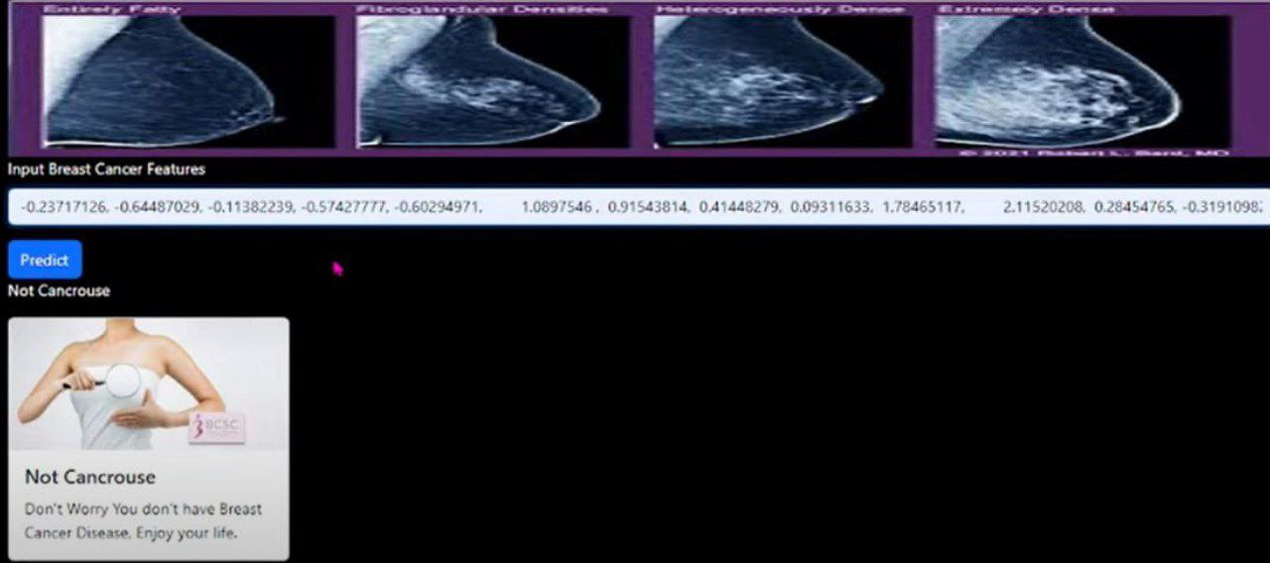
SNIPPET

Slide 15
References
https://www.who.int/cancer/prevention/diagnosis-screening/breastcancer/en/
https://towardsdatascience.com/building-a-simple-machine-learning-model-on- breast-cancer-data-eca4b3b99fa3
Confusion Matrix: https://tatwan.github.io/How-To-Plot-A- Confusion-Matrix- In-Python/
https://seaborn.pydata.org/tutorial/axis_gri ds.html
https://seaborn.pydata.org/generated/seaborn.pairplot.html
https://seaborn.pydata.org/generated/seaborn.heatmap.html
https://www.kaggle.com/datasets/yasserh/breast-cancer-dataset

Slide 16
course certificate 1

Slide 17
course certificate 2

Slide 18
THANK YOU

